Slide 1

Better Training for Safer Food Initiative
Wild boar data collection in ASF infected areas
Tomasz Podgórski
BTSF
This presentation is delivered under contract with the Consumers, Health, Agriculture and Food Executive Agency (http://ec.europa.eu/chafea). The content of this presentation is the sole responsibility of Opera S.u.r.l., the Istituto Zooprofilattico Sperimentale Lombardia e Emilia Romagna and the State Food and Veterinary Service of Latvia and it can in no way be taken to reflect the views of the Consumers, Health, Agriculture and Food Executive Agency or any other body of the European Union. The Consumers, Health, Agriculture and Food Executive Agency or any other body of the European Union will not be responsible under any circumstances for the contents of communication items prepared by the contractors.

Slide 2
Wild boar - surveillance
Wildlife surveillance mostly linked to hunting;
Sampling rather irregular;
Hunting seasonally limited;
Rarely adequate number of samples collected;
Mostly serological tests performed – only retrospective analysis.

Slide 3
Infected area
…
Wild boar home range, geographical distribution;
Landscape structure;
All the suitable wild boar habitat in geographical continuity;
Borders defined by artificial or natural barriers;
Not less than 200 km2…
…
Notes:
Definition of the infected area
But how do we perform sampling

Slide 4
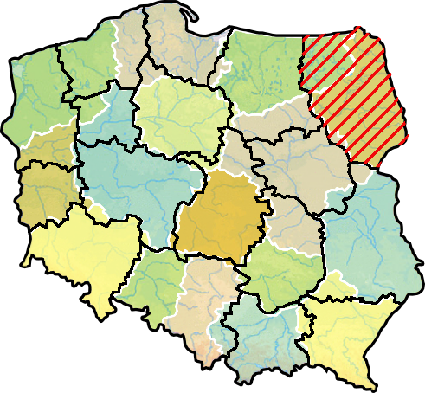
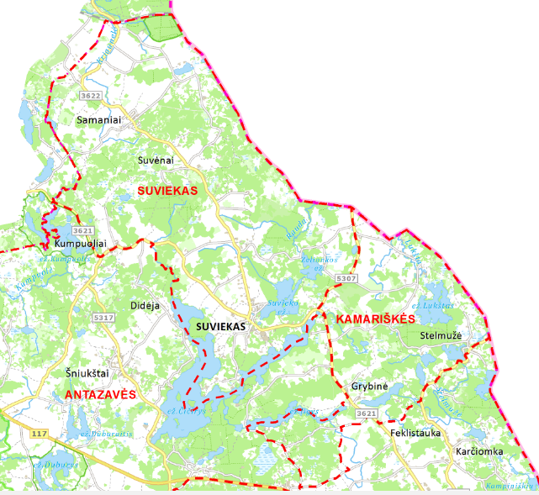
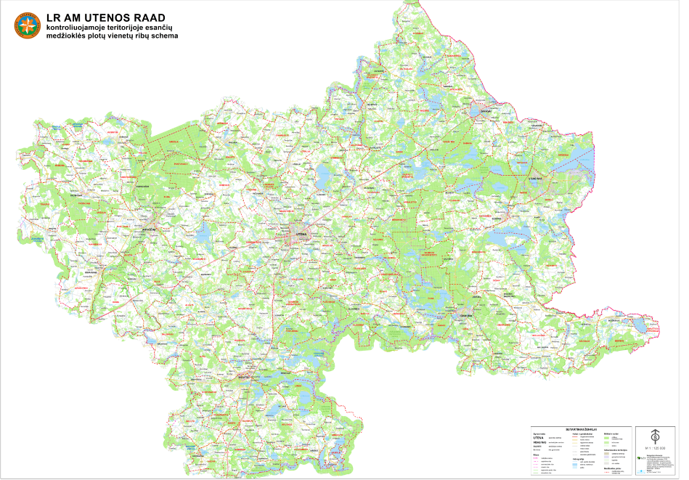
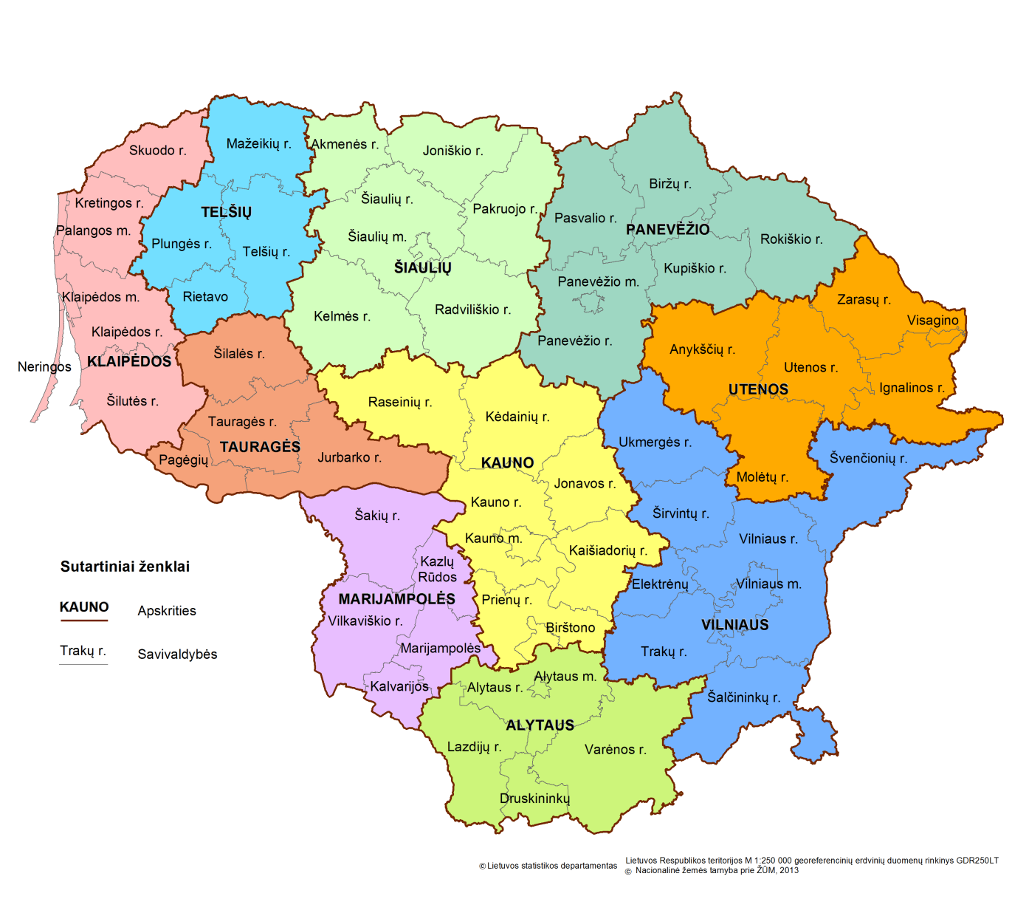
Data collection
Notes:
The country divided into hunting grounds, not correlate with the administrtive borders,
Which units do we use for sampling

Slide 5
Measures in the infected area
Appropriate control and eradication measures have to be implemented in the infected area and these may include suspension of hunting and a ban on feeding wild boar.
Disease monitoring programme - to be enforced after a period of at least 12 months has elapsed since the date of the last confirmed case and it shall stay in place for at least 12 additional months.

Slide 6
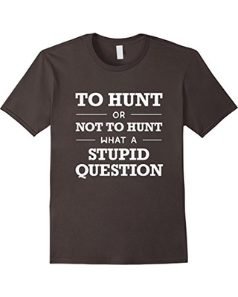
To hunt or not to hunt?
Hunting wild boars could appear a simple and direct way to manage the number of susceptible animals in order to facilitate the control and the eradication of ASF.
However, hunting pressure may be counterproductive, since it may increase the size of the home-range of wild boar meta populations, facilitating contacts between meta-populations, and promoting long distance movements of individual animals.

Slide 7
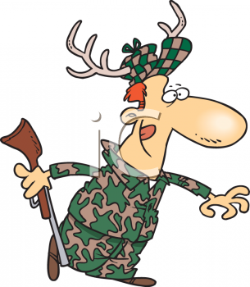
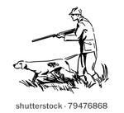
To hunt or not to hunt?
Hunting may pose some additional risks, namely those related to the handling of infected carcasses and possible dispersal of virus in the environment by hunters.
However, hunting may be necessary for sampling purposes...

Slide 8
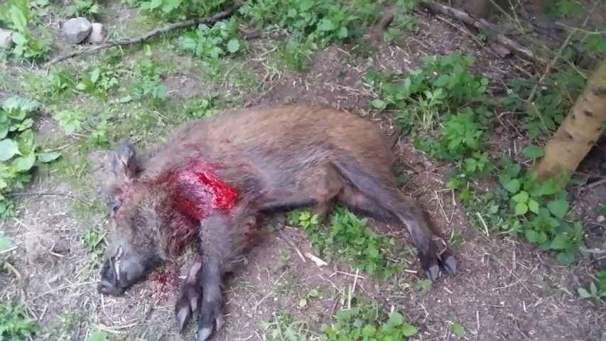
Hunting in the infected area
Targeted hunting (mainly young wild boar under one year of age) is assumed to temporarily decrease the number of susceptible animals and thus it should facilitate the fading out of the infection…?
However, harvesting juveniles may leave enough breeding females to maintain a high birth rate, yielding susceptible animals that enable the disease to persist…

Slide 9
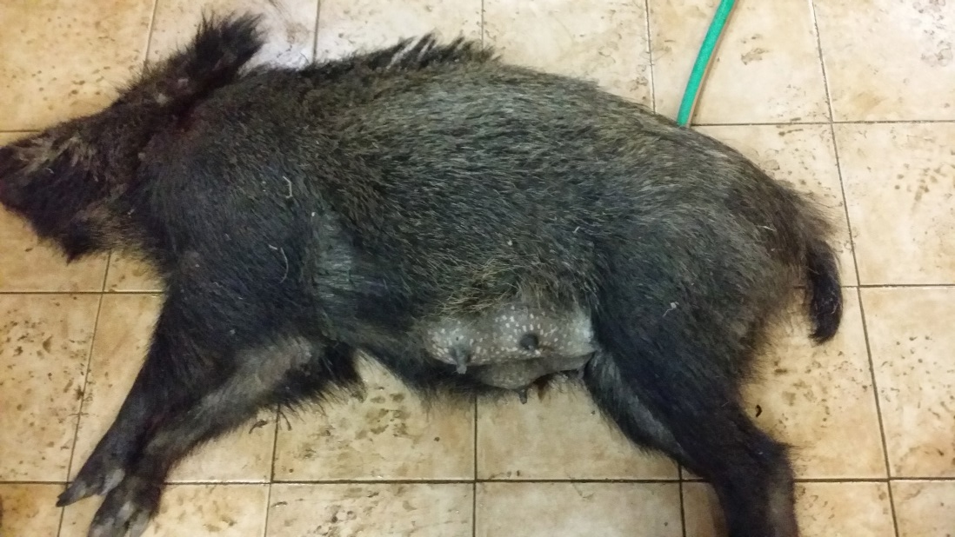
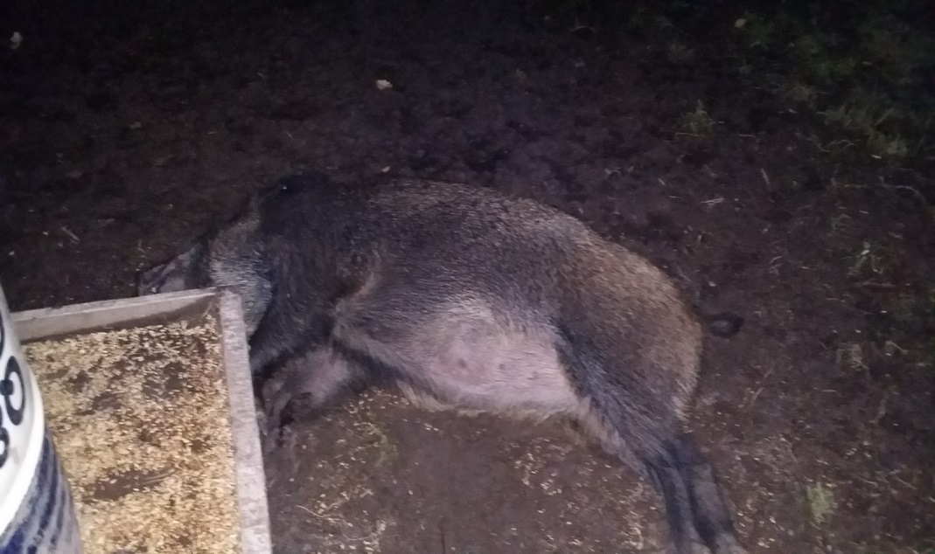
Hunting in the infected area
Alternatively, hunting targeting breeding females would decrease the population long-term.
Notes:
But Eliminating the females may destroy group structure and cause groups re-arrangements

Slide 10
Wild boar fertility

Slide 11
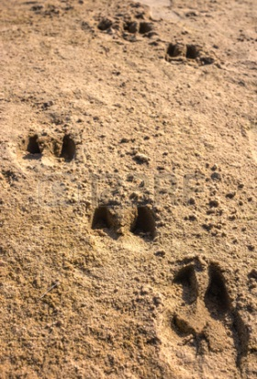
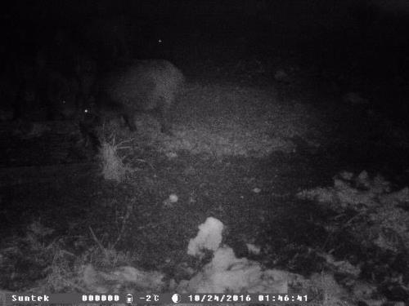
Wild boar density - how to estimate??

Slide 12
Estimation methods
Driven count– counting of animals driven away from a forest
area surrounded by observers (direct method) with silent beater:
• on 10% of the area covered by animals’ counting;
• with a use of observers and beater (app. 50-70 persons);
• calculation error – around 20%;
• experienced personnel (discipline – extremely important) – to avoid double counting of the same animals;
• in winter – lack of leaves on the trees – good vision;
• additional information on animals age and sex can be obtained.

Slide 13
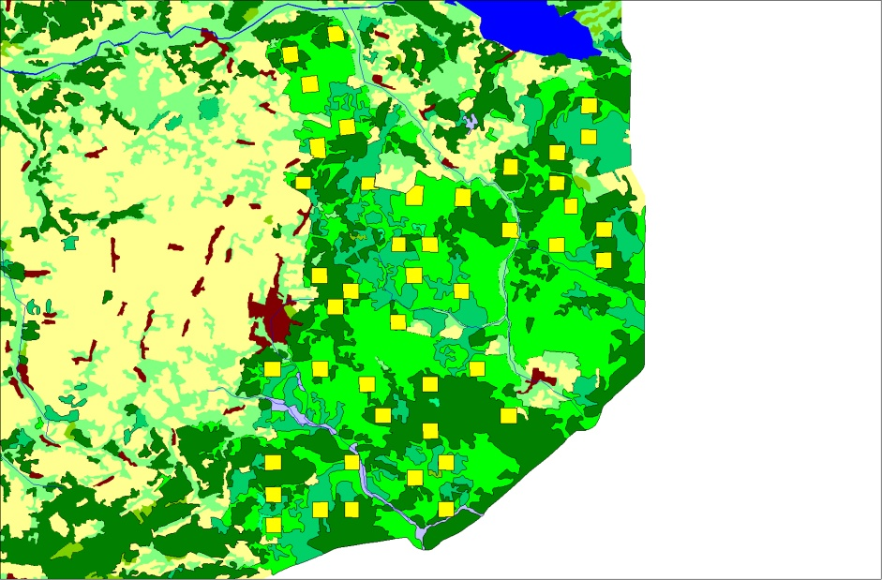
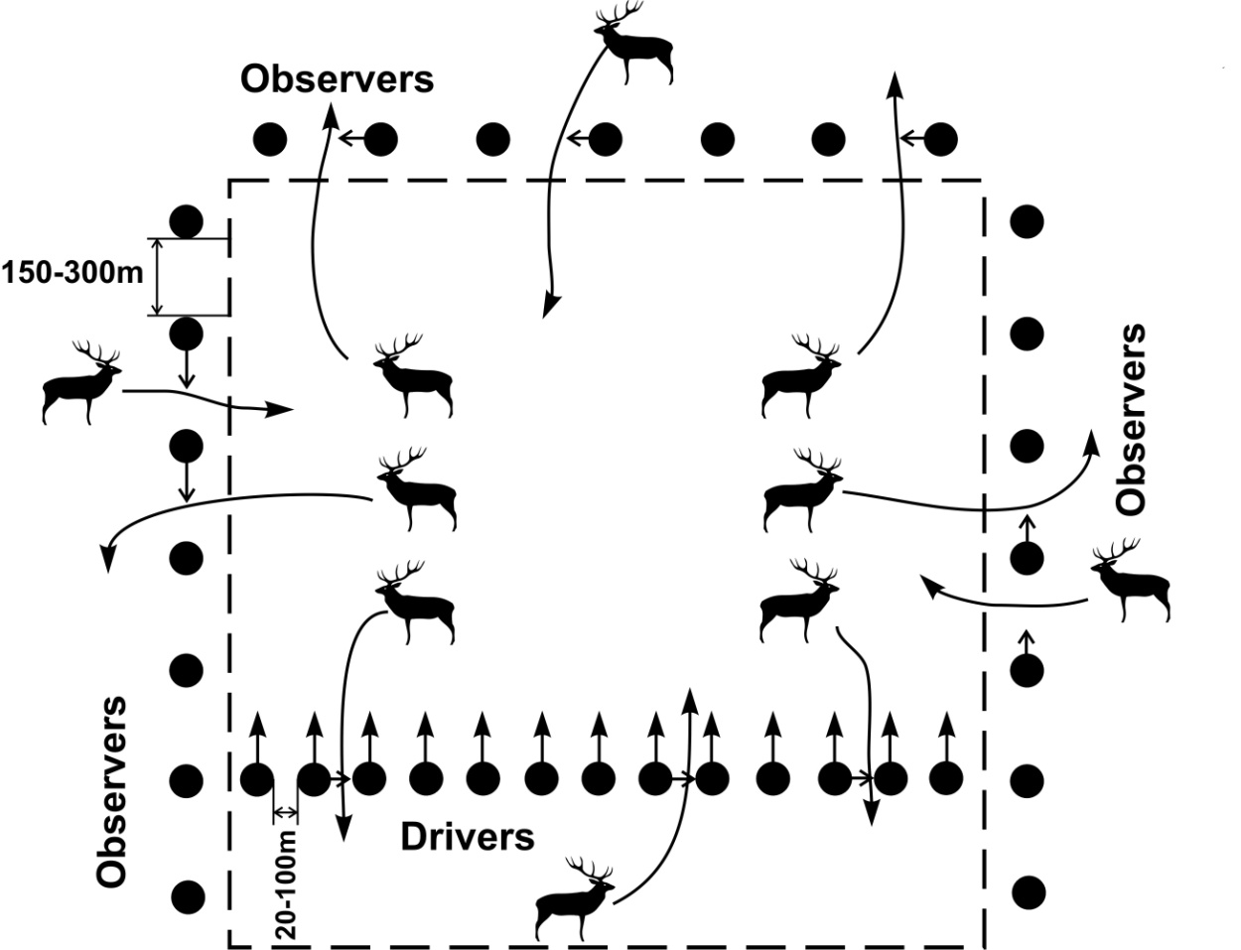
Estimation methods - driven count

Slide 14
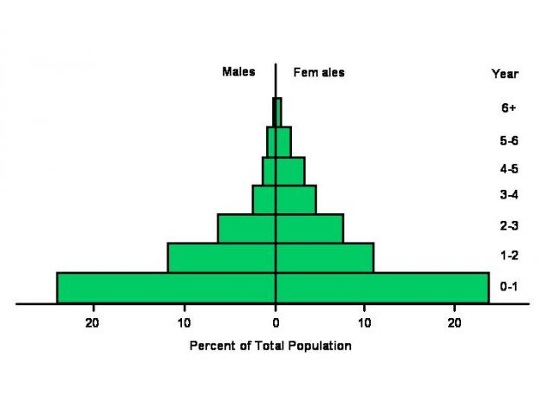
Wild boar - population
Population pyramid showing the sex and age class composition of a typical population.

Slide 15
Wild boar hunting management
During a year, typically the hunting quota consists of the following age groups of wild boar:
sub adults under 1 year of age: 40 – 60%,
young wild boar between 1 and 2 years of age: 20 – 40%,
adults (more than 2 years of age): up to 20%.
The proportion of sexes of wild boar in the hunting quota should be 1:1.

Slide 16
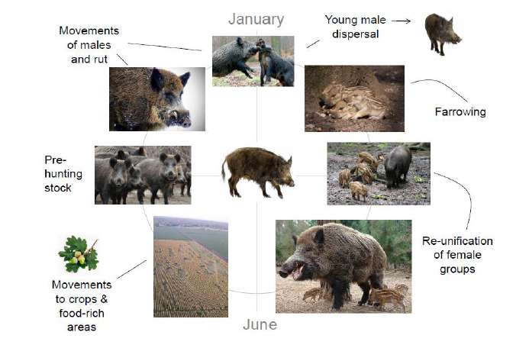
Notes:
Life-cycle

Slide 17
Seasonal dependence of ASF in wild boar in LT
Notes:
Drivers of increase: population size,

Slide 18
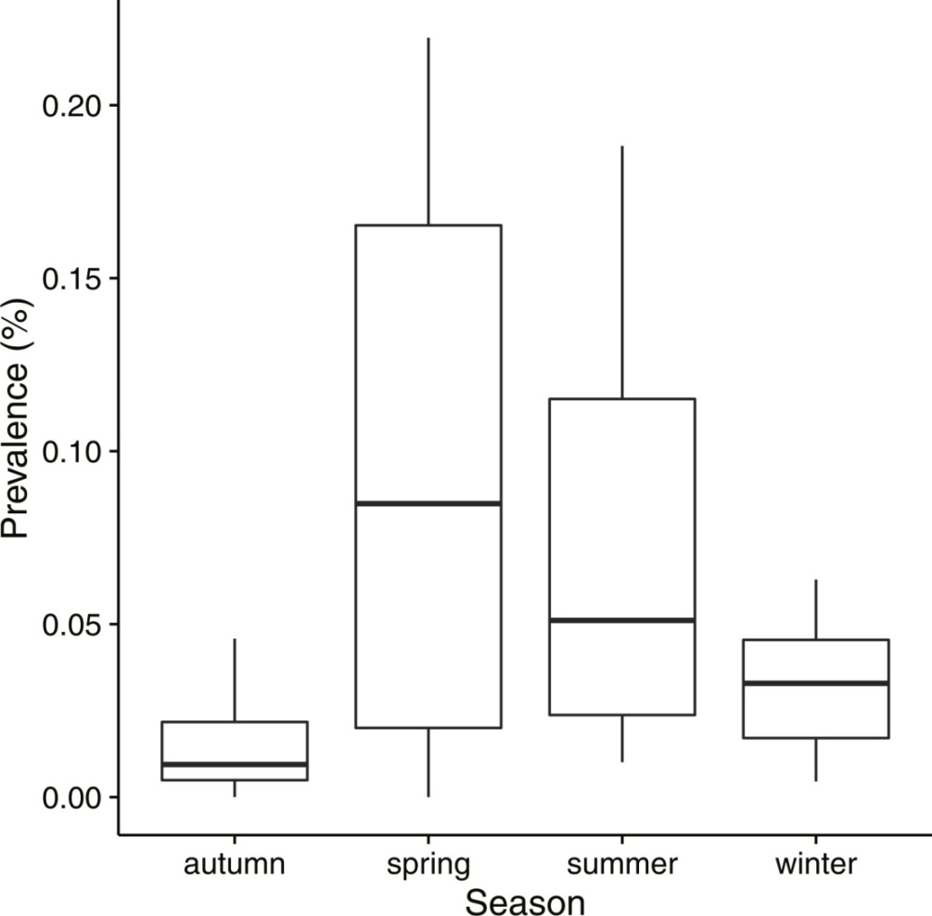
Seasonal dependence of ASF in wild boar in PL (2014-2015)
Notes:
Drivers of increase: population size,

Slide 19
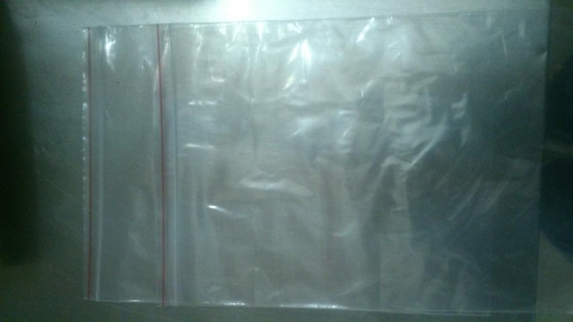
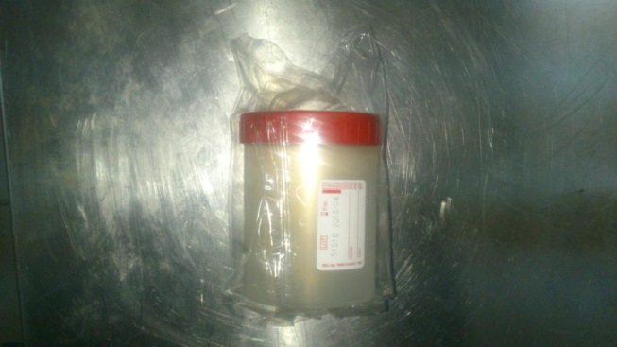
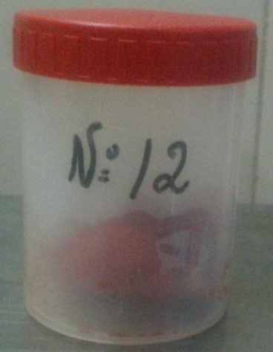
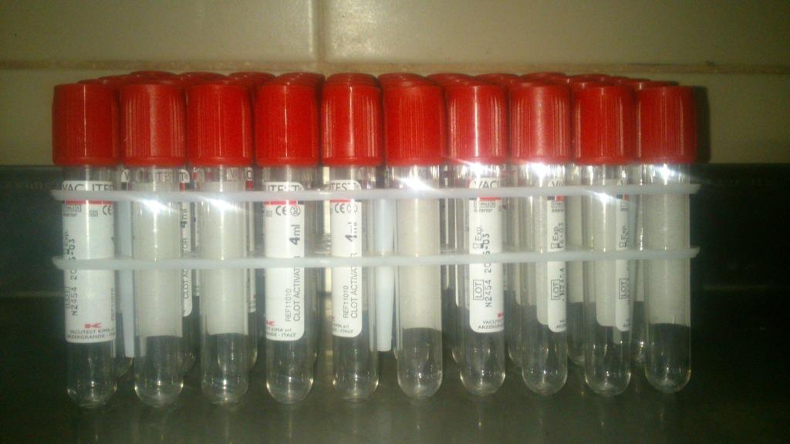
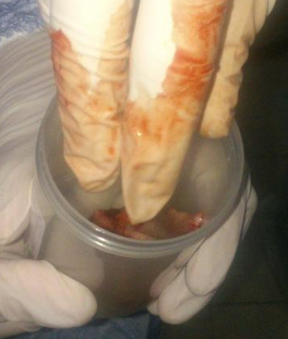
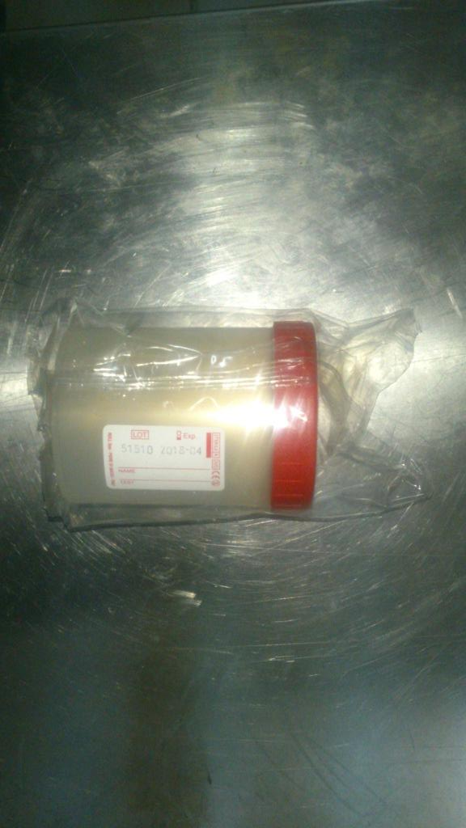
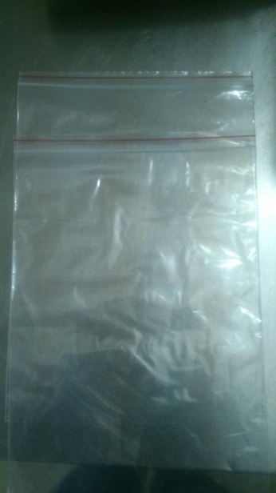
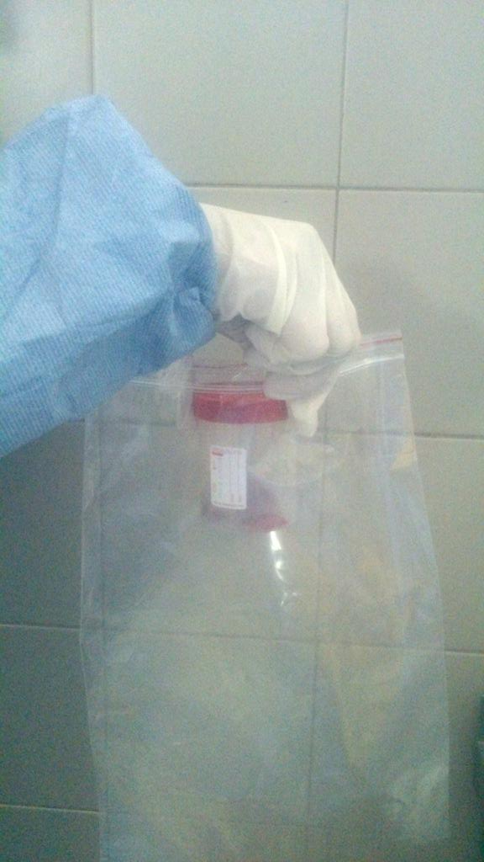
Sampling
Notes:
Biosecurity during sampling, we dont know the infectious status of sampled animals

Slide 20
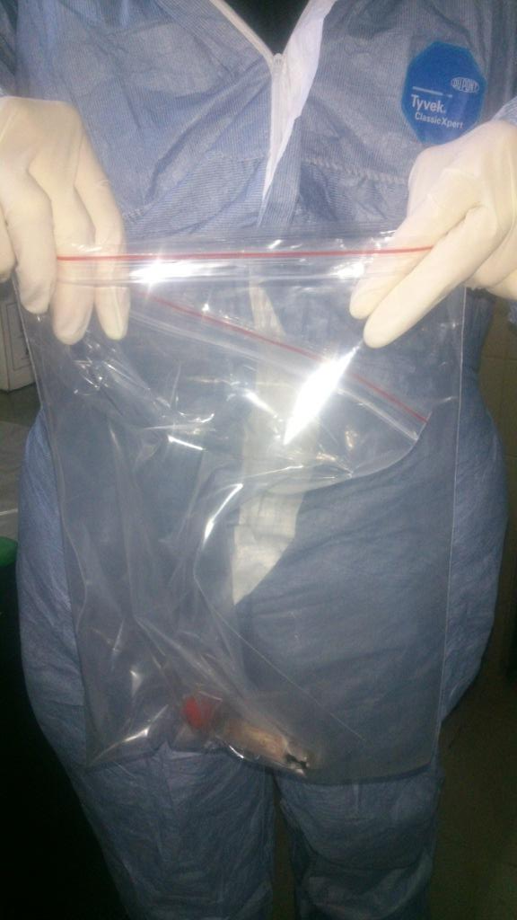
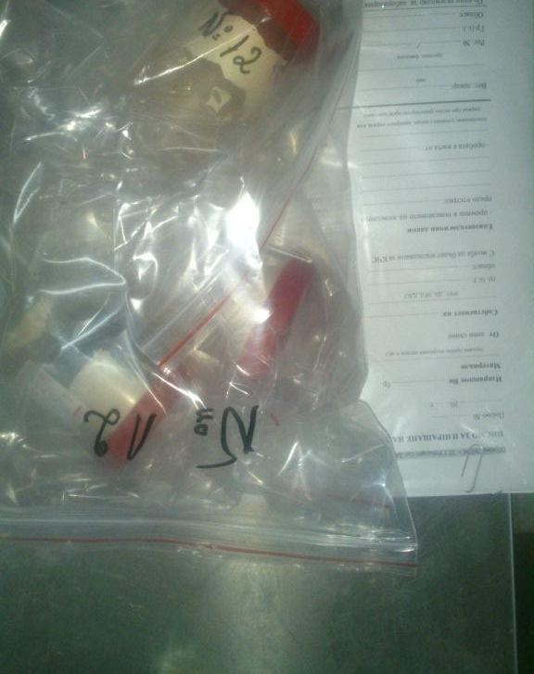
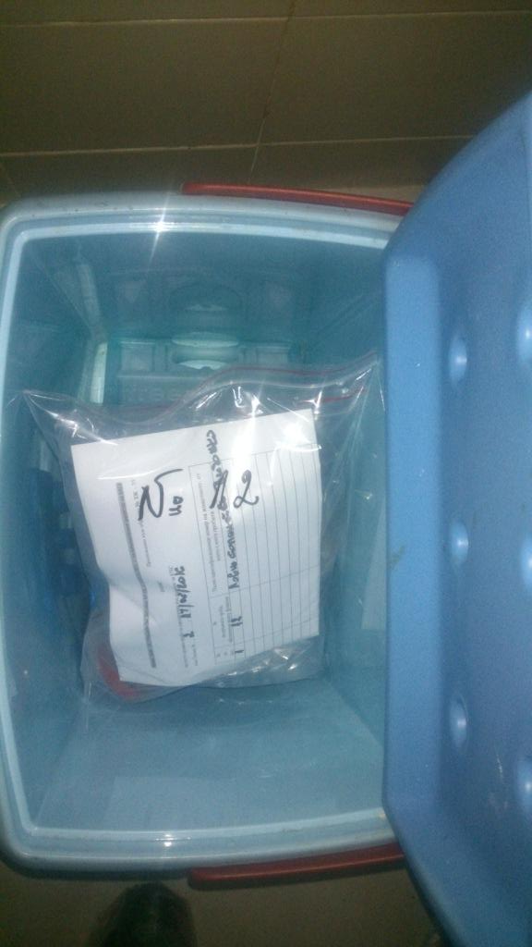
Sampling
Notes:
Tracebility of the samples, age/sex , geographical coordinates or accurate location very important!

Slide 21
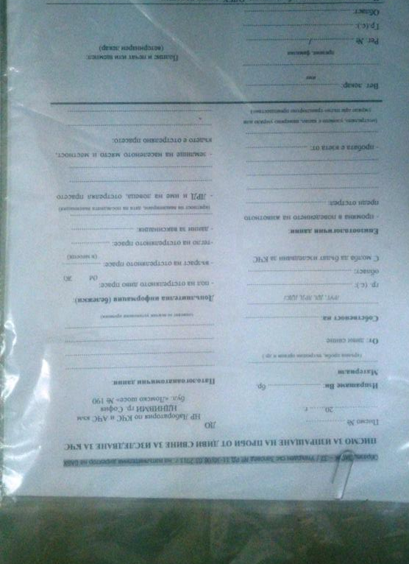
Sampling
Identification of the samples:
-Name of the person submitting the sample;
-Date;
-Geo-coordinates of the place where the animal was shot;
-Species, age, sex and weight of the animal;
-Lesions observed;
-Description of the submitted samples;
-Any other relevant information.
Delivery to the laboratory:
-Within 24 hours;
-Approved trained courier.

Slide 22
ASF Strategy for Eastern Part of the EU
Wild boar sampling:
Principle of sampling in the whole country should be based on enhanced passive surveillance: all found dead and sick wild boar have to be tested for ASF using qRT-PCR.
Removal of carcasses:
To be based on the enhanced passive surveillance already in place. In case of detection of ASF in precedent unaffected areas, the passive finding of carcasses should be supplemented by active search by professionals in hotspots established by the competent authority.
Notes:
Areas to be targeted by carcass search: swamps, river valleys (fever!)

Slide 23
ASF strategy
Passive surveillance:
Best surveillance for the early detection of almost all infectious diseases and in particular for ASF in wild boars;
Active surveillance is useless for early detection in free and at risk areas but good tool in already infected areas for estimation of disease prevalence.

Slide 24
ASF strategy
Need to be tested:
All found dead or killed in road incidents wild boar!
Any hunted wild boar showing any abnormal behaviour.

Slide 25
Thank you for your kind attention!

Slide 26
This presentation is delivered under contract with the Consumers, Health, Agriculture and Food Executive Agency (http://ec.europa.eu/chafea). The content of this presentation is the sole responsibility of Opera S.u.r.l., the Istituto Zooprofilattico Sperimentale Lombardia e Emilia Romagna and the State Food and Veterinary Service of Latvia and it can in no way be taken to reflect the views of the Consumers, Health, Agriculture and Food Executive Agency or any other body of the European Union. The Consumers, Health, Agriculture and Food Executive Agency or any other body of the European Union will not be responsible under any circumstances for the contents of communication items prepared by the contractors.
Opera S.u.r.l.
Viale Parioli 96 - 00197 Roma - Italy
Tel +39 06 96042652 / +39 06 8080111
Fax +39 06 89280678
info@opera-italy.it; www.btsftraining.com; www.opera-italy.it
European Commission Consumers, Health, Agriculture and Food Executive Agency DRB A3/042 L-2920 Luxembourg

