Slide 1

Better Training for Safer Food
Initiative
BTSF
ASF International legislation
This presentation is delivered under contract with the Consumers, Health, Agriculture and Food Executive Agency (http://ec.europa.eu/chafea). The content of this presentation is the sole responsibility of Opera S.u.r.l., the Istituto Zooprofilattico Sperimentale Lombardia e Emilia Romagna and the State Food and Veterinary Service of Latvia and it can in no way be taken to reflect the views of the Consumers, Health, Agriculture and Food Executive Agency or any other body of the European Union. The Consumers, Health, Agriculture and Food Executive Agency or any other body of the European Union will not be responsible under any circumstances for the contents of communication items prepared by the contractors.

Slide 2

OIE Terrestrial Animal Health Code: www.oie.int/en/internationalstandard-setting/terrestrial-code/ access-online/
OIE Manual of Diagnostic Tests and Vaccines for Terrestrial Animal: www.oie.int/en/internationalstandard-setting/ terrestrial-manual/access-online/
OIE Technical Disease Card: www.oie.int/en/animalhealth-in-the-world/ technical-disease-cards/

Slide 3
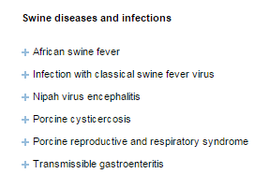
OIE-Listed diseases, infections and infestations in force in 2016

Slide 4
Principles of the disease control strategy – examples of EU
Control measures against major animal epizootic diseases
Contingency plans in each MS for dealing with epizootic diseases
Eradication and monitoring programmes for diseases already in the Community
Diagnostic Manual to assure uniform procedure to diagnose animal diseases
Network of EU and MSs Ref Laboratories
Community Veterinary Emergency Team (CVET)
Training
Scientific advise – EFSA
EU research projects

Slide 5
Main legislation in force on ASF in EU (1)
Council Directive 2002/60/EC of 27 June 2002 laying down specific provisions for the control of African swine fever and amending Directive 92/119/EEC as regards Teschen disease and African swine fever
Commission Decision 2014/709/EU of 9 October 2014 concerning animal health control measures relating to ASF in certain Member States and repealing Implementing Decision 2014/178/EU
Commission Decision 2013/426/EU of 5 August 2013 on measures to prevent the introduction into the Union of ASF from certain third countries or parts of the territory of third countries in which the presence of that disease is confirmed and repealing Decision 2011/78/EU

Slide 6
Main legislation in force on ASF in EU (2)
SANCO/7138/2013 - Guidelines on surveillance and control of African swine fever in feral pigs and preventive measures for pig holdings
SANCO/7112/2015 – Principles and criteria for geographically defining ASF regionalisation
SANCO/7113/2015 – ASF Strategy for Eastern Part of the EU

Slide 7
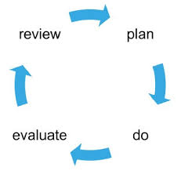
Contingency planning
Dynamic process, focused on preparation and is flexible;
It is integrated into on-going operational planning activities;
It provides useful input to emergency managers;
It is an integral part of preparedness activities!
Contingency planning is an ongoing process…

Slide 8
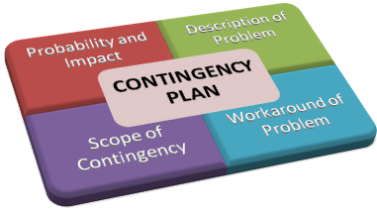
What is a contingency plan?
a plan to ensure that a country or region is prepared for an emergency;
consist information on legislative and administrative aspects, resources;
consist of description of procedures for effective disease control measures;
An ASF contingency plan should be a well-articulated strategy document designed to define actions to be taken in the event of an ASF emergency!

Slide 9
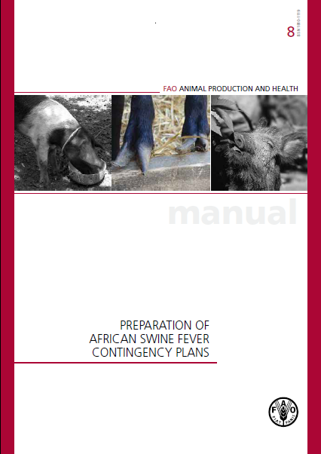
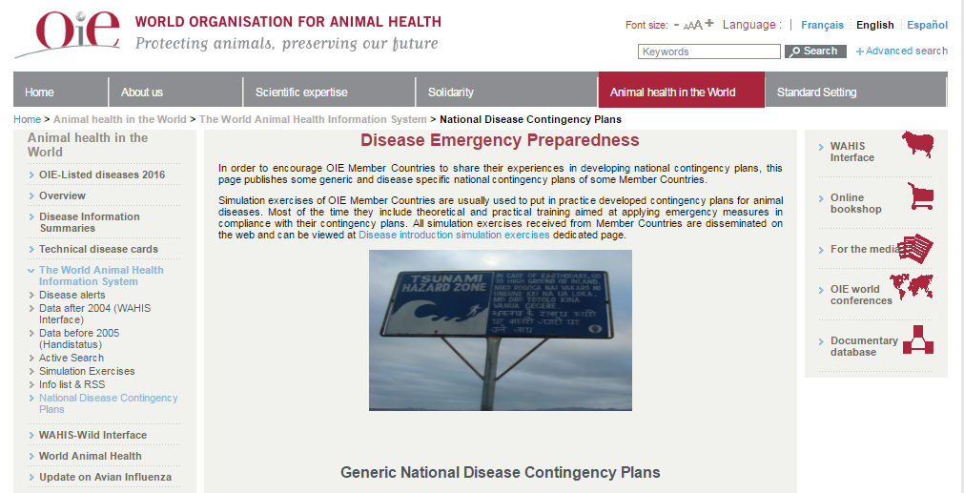
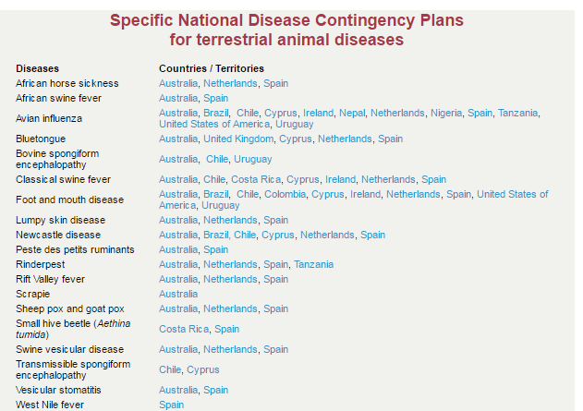
The ASF Contingency plan

Slide 10
Contingency plans - EU Guidelines
Legal powers
Financial provisions
The chain of command
Establish the national disease control centre
The local disease control centres
Laboratory
Communications
Expert groups
Provision for adequate resources
Instruction manual
Training
Alarm drills
Publicity/ disease awareness
Notes:
9

Slide 11

Legal powers
the notification of suspected disease
the access to holdings keeping animals
the application of stamping-out policy
the application of animal welfare requirements
the payment of compensation
the control of movements

Slide 12

Financial provisions
A country shall ensure that it has the budgetary powers to cover the costs of all aspects of an epidemic:
personnel over and above normal running costs
slaughter and destruction of carcasses
compensation payments to owners of animals
sanitation

Slide 13

The chain of command
A chain of command shall be established guaranteeing a rapid and effective decision-making for dealing with disease outbreaks
Different arrangements in the countries reflecting size, administrative history, power distributions etc.
A National Disease Control Centre (NDCC)
A Local Disease Control Centre (LDCC)

Slide 14

Expert groups
maintain the expertise needed to assist the competent authority in ensuring disease preparedness;
shall assist the competent authority at least in:
- the epidemiological enquiry;
- sampling, testing and interpretation of results of laboratory tests;
- establishment of disease control measures.

Slide 15

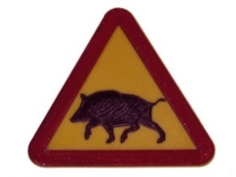
Expert group assistance in a case of ASF in wild boars
studying the epidemiological situation and defining an infected area
establishing appropriate measures to be applied in the infected area
drawing up the eradication plan to be submitted to the Commission
carrying out checks to verify the effectiveness of the measures adopted to eradicate ASF from the infected area.

Slide 16
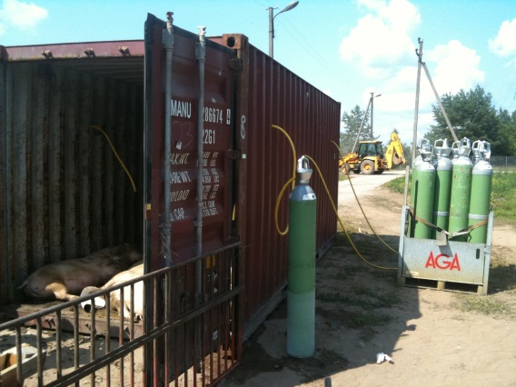
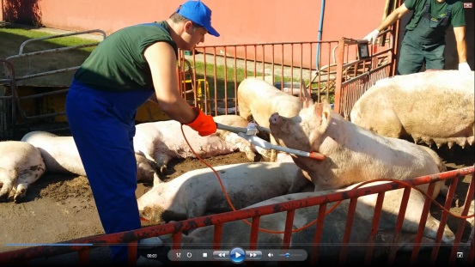
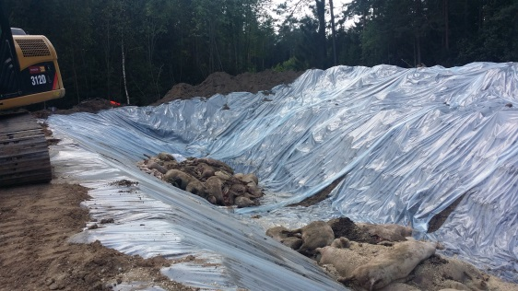
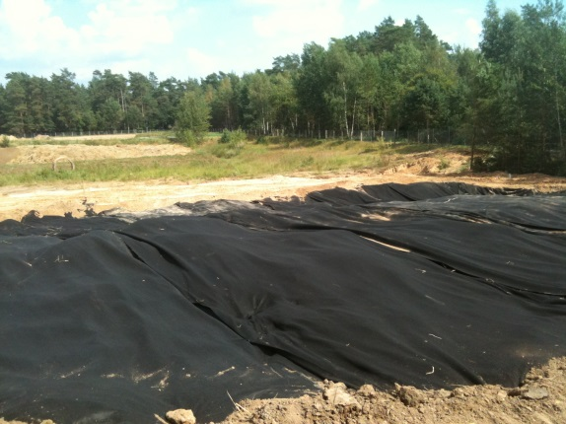
Operational manual – an example
Operational manual for stamping out:
The strategy of eliminating infection from premises through the destruction of animals and in a manner that permits appropriate disposal of carcasses and decontamination of the site.

Slide 17
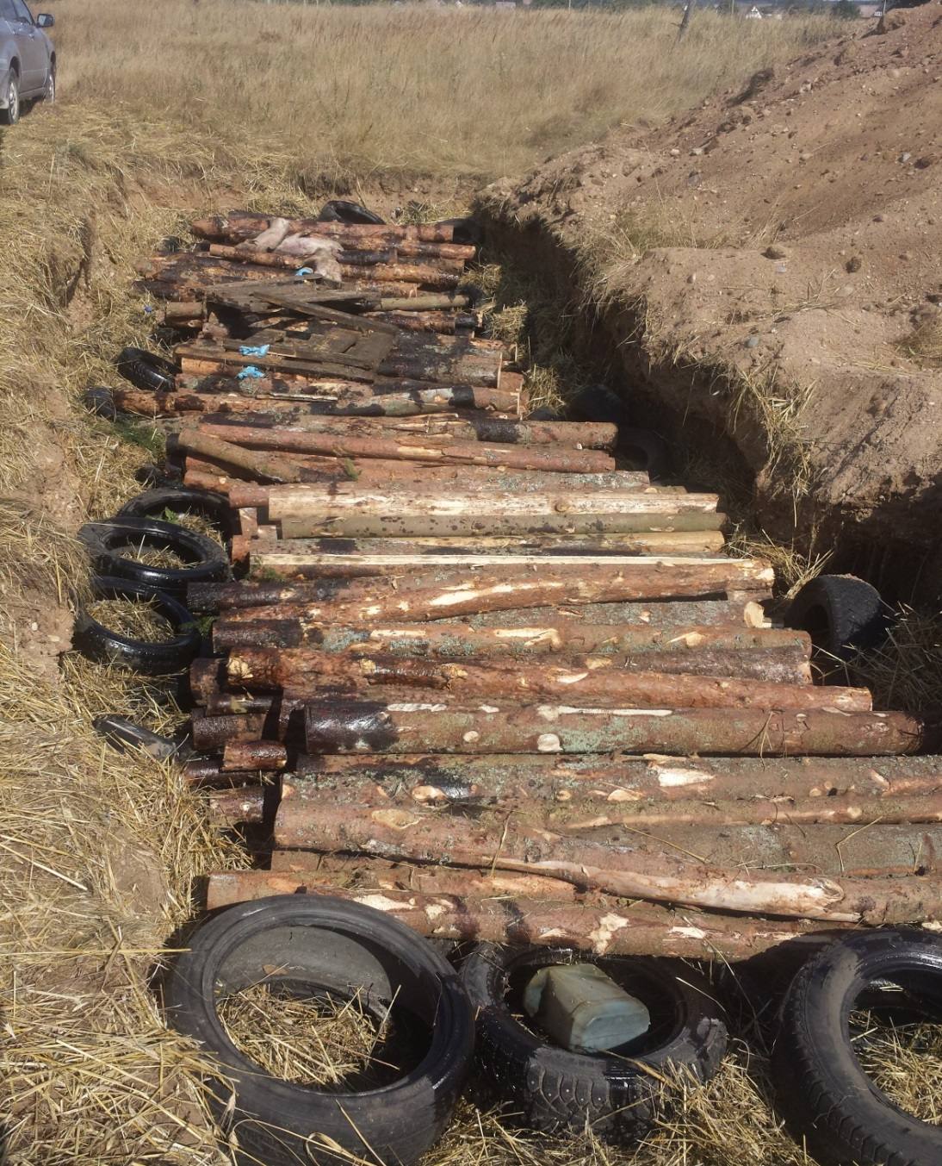
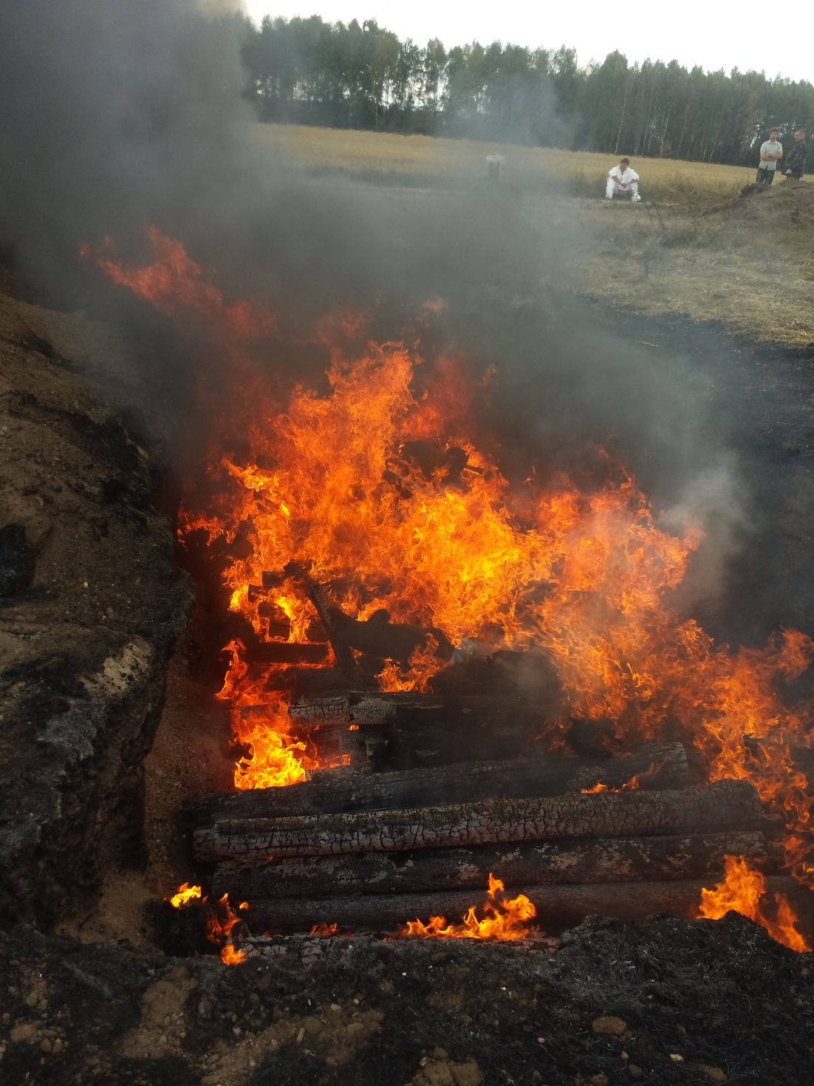
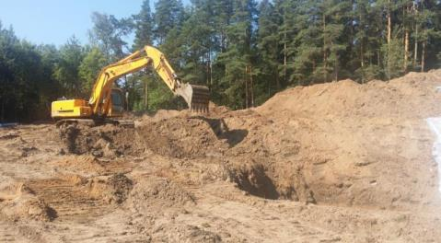
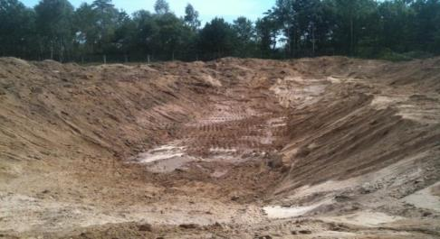
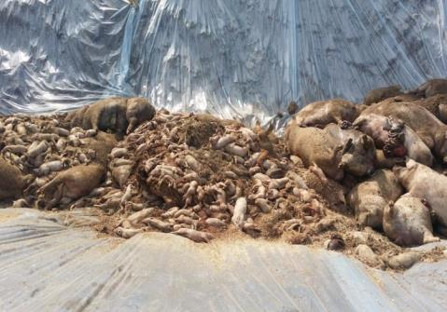
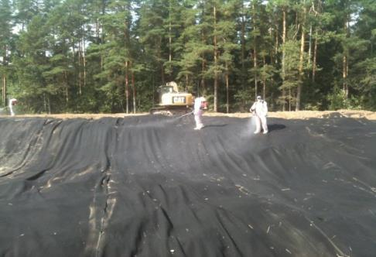

Slide 18

Training activities
Animal health staff should be trained in:
General steps to be taken in emergencies
Diagnosis, including collection and transport of specimen
Epizootical investigation
Biosecurity actions
Disinfection and disposal procedures
Traceability and documentation
Information exchange and public awareness procedure
Training levels:
Specialized training for expert teams
General trainings for supporting personnel
Public awareness via media
Experts
Public
Supported staff

Slide 19
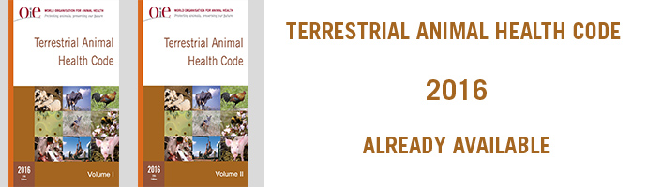

Slide 20

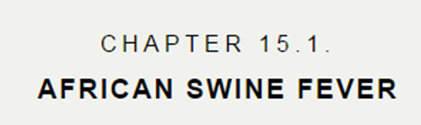
VOLUME II
Recommendations applicable to OIE Listed diseases and other diseases of importance to international trade

Slide 21
VOLUME II
Recommendations applicable to OIE Listed diseases and other diseases of importance to international trade
Determination of the ASF status of a country, zone or compartment
ASF free country, zone or compartment
Recovery of free status
Recommendations for importation from ASF free countries, zones or compartments
Recommendations for importation from countries or zones considered infected with ASF …

Slide 22
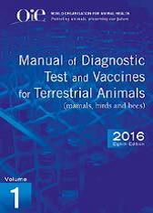
Commission Decision 2003/422/EC of 26 May 2003 approving an African swine fever diagnostic manual
covers standards for diagnostic tests and vaccines

Slide 23
Commission Decision 2003/422/EC of 26 May 2003 approving an African swine fever diagnostic manual
lays down uniform diagnostic procedure, sampling methods and criteria for the evaluation of the results of lab tests:
  How to recognize ASF and principles for differential diagnosis
  Main criteria to be considered for the recognition of a suspect holding
  Checking and sampling procedures, samples collection and transport
  Virological tests and results evaluation
  Serological tests and results evaluation
  Safety requirements for Labs

Slide 24
Surveillance programme for ASF – EU strategy
SANTE/7113/2015
Domestic pigs in the infected area:
Sampling for laboratory investigations will be performed:
in case of clinical signs (such as fever or haemorrhagic lesions)
Increased mortality and mortality due to suspected infectious disease
Ante-and post-mortem signs raising suspicion at home slaughtering within the area covered by Commission Decision 2014/709/EU.

Slide 25
Surveillance programme for ASF – EU strategy
SANTE/7113/2015
Wild boar:
Principle of sampling in the whole country should be based on enhanced passive surveillance: all found dead and sick wild boar have to be tested for ASF using qRT-PCR.
Additional sampling (active surveillance) from hunted animals
In the infected area (Part II and III) sampling of all hunted animals and of all found dead/sick animals has to be conducted (100% sampling and testing by qRT-PCR). The hunted animals of these areas should be tested additionally for antibodies against ASF virus.
From hunted animals only blood samples are requested (no organs)

Slide 26
Thank you for your attention!

Slide 27
This presentation is delivered under contract with the Consumers, Health, Agriculture and Food Executive Agency (http://ec.europa.eu/chafea). The content of this presentation is the sole responsibility of Opera S.u.r.l., the Istituto Zooprofilattico Sperimentale Lombardia e Emilia Romagna and the State Food and Veterinary Service of Latvia and it can in no way be taken to reflect the views of the Consumers, Health, Agriculture and Food Executive Agency or any other body of the European Union. The Consumers, Health, Agriculture and Food Executive Agency or any other body of the European Union will not be responsible under any circumstances for the contents of communication items prepared by the contractors.
Opera S.u.r.l.
Viale Parioli 96 - 00197 Roma - Italy
Tel +39 06 96042652 / +39 06 8080111
Fax +39 06 89280678
info@opera-italy.it; www.btsftraining.com;
www.opera-italy.it
European Commission
Consumers, Health, Agriculture and Food Executive Agency
DRB A3/042
L-2920 Luxembourg

