Slide 1

Better Training for Safer Food Initiative
BTSF
ASF in wild boar
This presentation is delivered under contract with the Consumers, Health, Agriculture and Food Executive Agency (http://ec.europa.eu/chafea). The content of this presentation is the sole responsibility of Opera S.u.r.l., the Istituto Zooprofilattico Sperimentale Lombardia e Emilia Romagna and the State Food and Veterinary Service of Latvia and it can in no way be taken to reflect the views of the Consumers, Health, Agriculture and Food Executive Agency or any other body of the European Union. The Consumers, Health, Agriculture and Food Executive Agency or any other body of the European Union will not be responsible under any circumstances for the contents of communication items prepared by the contractors.

Slide 2
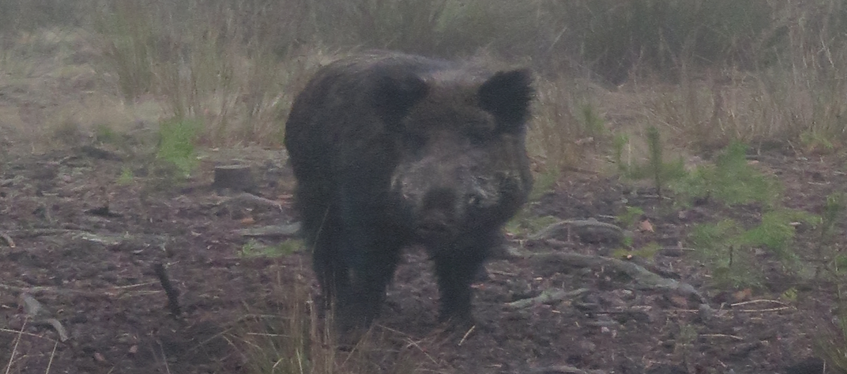
ASF in wild boar

Slide 3
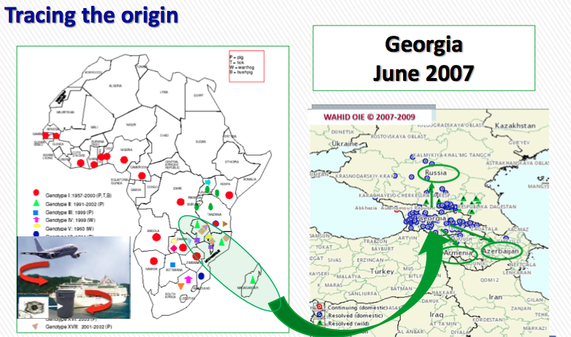

Slide 4
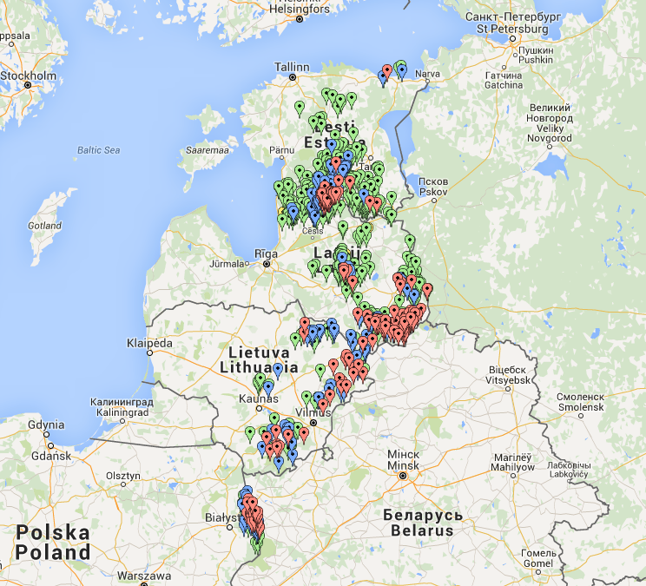

Slide 5
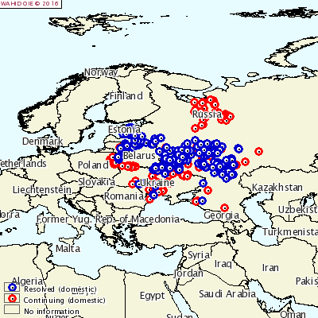

Slide 6
Few certainties
Wild boar is the true epidemiological reservoir of the virus
The virus is maintained by the wild boars independently from the infection in domestic pigs and ticks
Infected wild boar contaminate the environment making more likely secondary outbreaks in domestic pigs

Slide 7
How the virus spreads
Direct contacts (nose to nose)
Contaminated environment (infected material)
Feeding infected wild boar carcasses

Slide 8
Virus prevalence in infected wild boar population: 1-4,5%
Sero-prevalence in hunted WB: 0,5-2%
Incubation 3-5 days
Lethality 90-95%
78% found dead wild boar are virus positive
50 km/year is the average speed, but the virus lasts also in old infected areas
The virus spreads through the geographical continuity of the wild boar population and not because of wild boar migration!

Slide 9
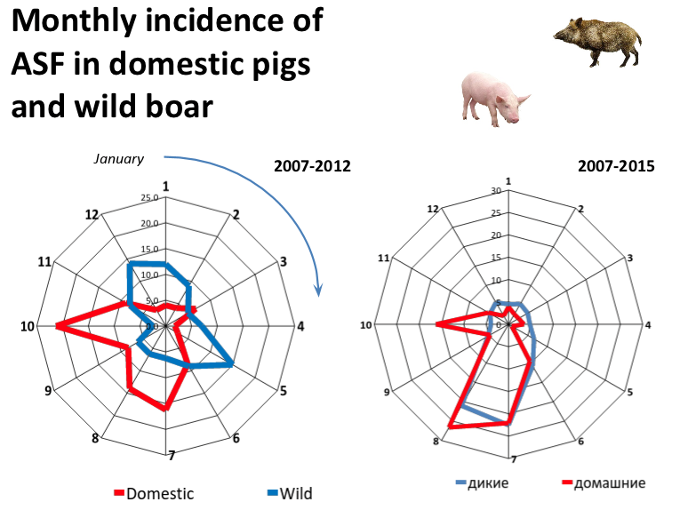

Slide 11
Summer peack
%
Autumn
Rutting
Winter
Time
Higher prevalence in summer: new born animals, maggots
Lower prevalence in winter: virus survives in carcasses
Increasing prevalence: rutting period

Slide 12
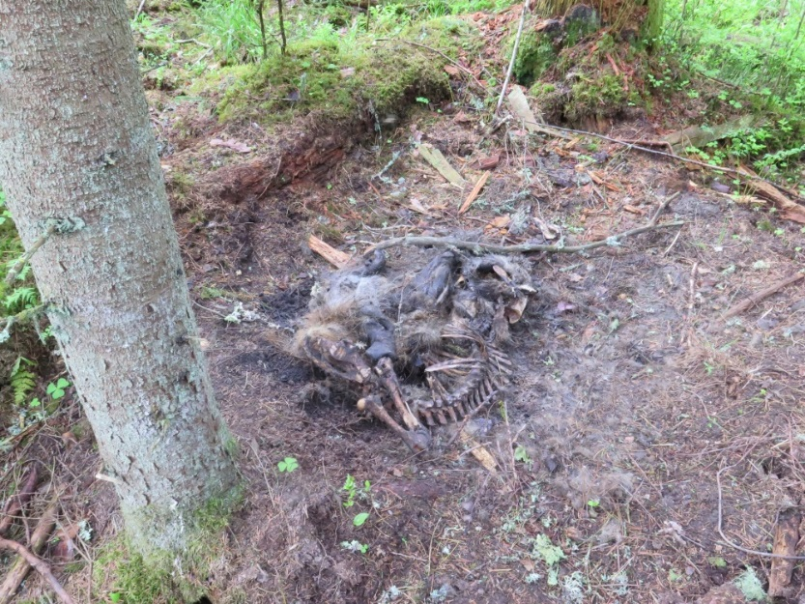
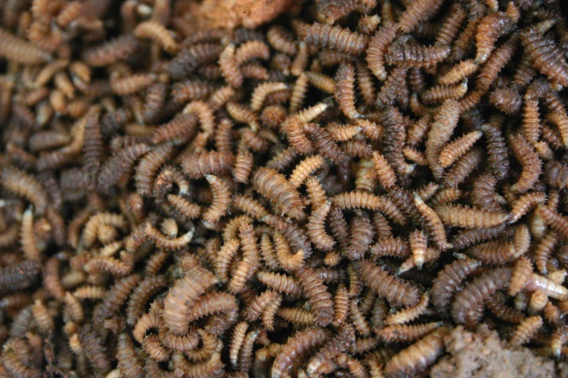
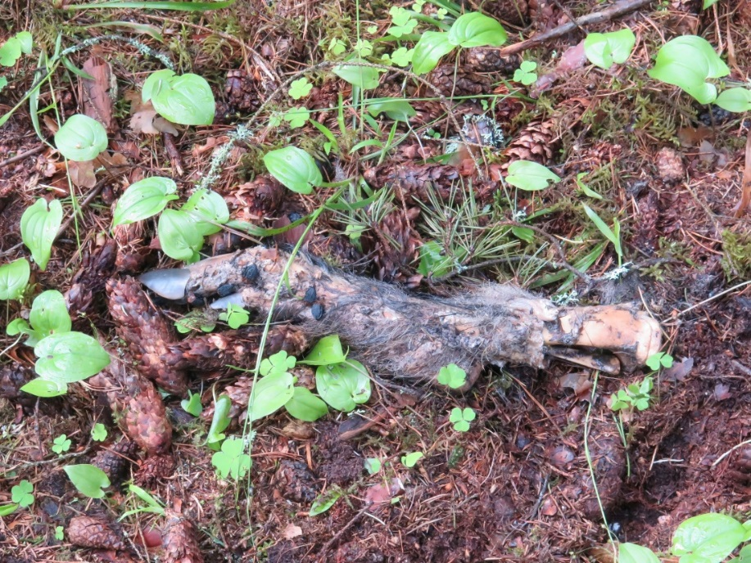
A directly transmitted virus which transmission is complicated by infected maggots, insects and carcasses

Slide 13
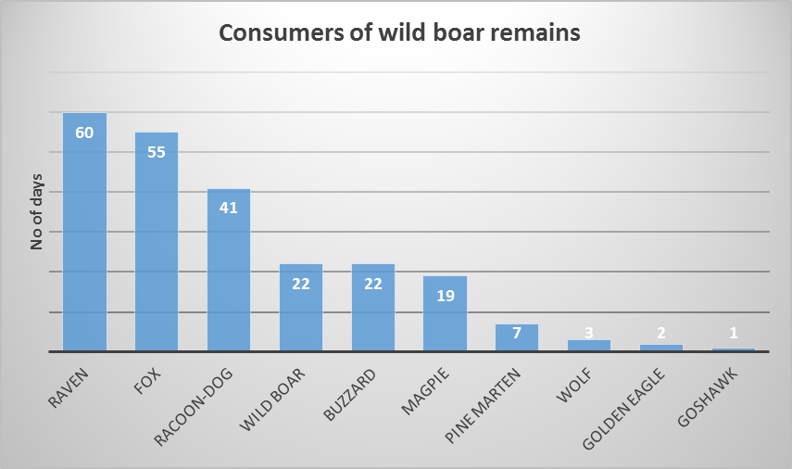
+ 19 wild boar approaches without contact

Slide 14
Role of insects and caracasses no ticks
Maggots could be contaminated by the virus: enhanced summer transmission
Scavenging insects: long attraction for wild boar, increased probability of direct contact with infected carcasses
Carcasses: virus maintenance in the environment; direct transmission to the susceptible animals

Slide 15
Risk of spread after introduction of the virus
Delayed diagnosis
Wild boar population size and density
Inappropriate hunting methodologies
Lack of biosecurity measures applied during hunting
Infected wild boar carcasses available for healthy wild boars
Poaching
Forest connectivity

Slide 16
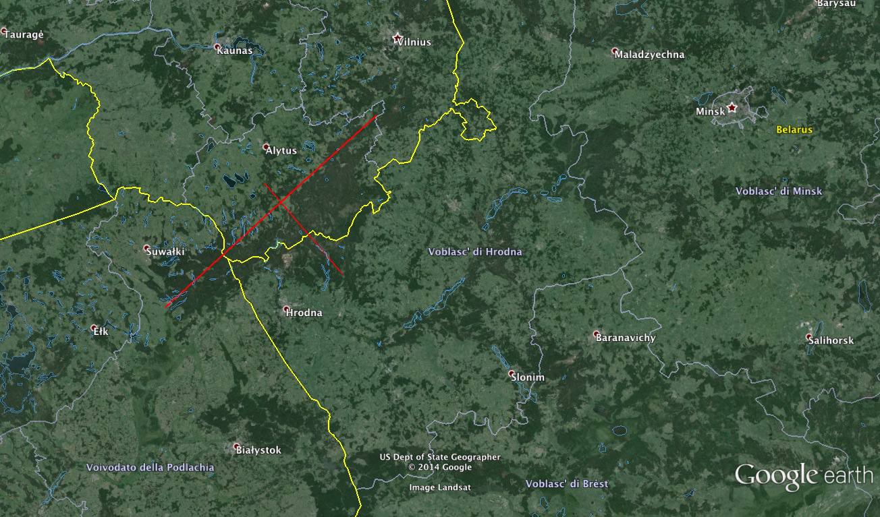
Geographical continuity
180 km
60 km

Slide 17
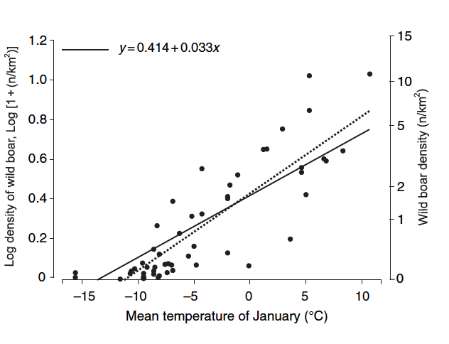
Winter feeding increases densities

Slide 18
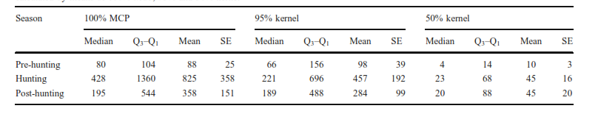
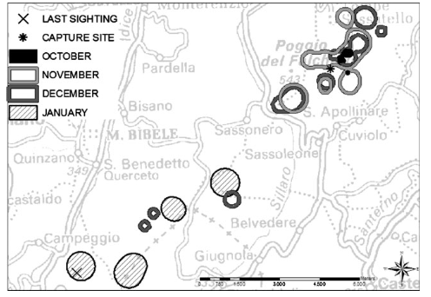
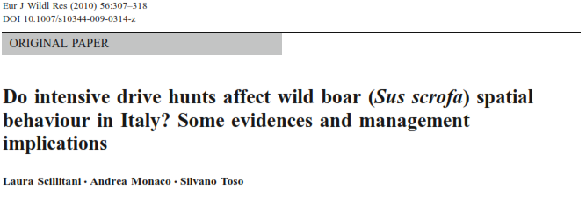
Hunting and wild boar movement
Drive hunting with dogs: increase of range size during the hunting season
Home range displacements during the hunting season (up to 15 km)
Notes:
Sposoby zarządzania populacjami zwierząt łownych mogą znacząco modyfikować ich zachowania socjalne i wzorce użytkowania przestrzeni
Dotychczasowe badania pokazują, że metody i intensywność pozyskania łowieckiego mogą mieć duży wpływ na behawior przestrzenny dzika. Polowania powodują reakcje ucieczkowe dzików i skutkują zwiększoną mobilnością i pokonywanymi dystansami w obrębie areałów osobniczych oraz sezonowe zwiększanie użytkowanej przestrzeni w okresie polowań
W badaniach prowadzonych w Niemczech i Szwecji, połowa obserwowanych zwierząt opuściła swoje areały po rozpoczęciu polowań z nagonką, przemieściła się na odległość od 2 do 20 km i powróciła do stale zajmowanego rejonu po 1-3 miesiącach od zakończenia polowań
Polowania indywidualne nie powodowały tak rozległych przemieszczeń, a czasem prowadziły wręcz do zmniejszenia aktywności w wyniku dłuższego przebywania dzików w miejscach ukrycia

Slide 19
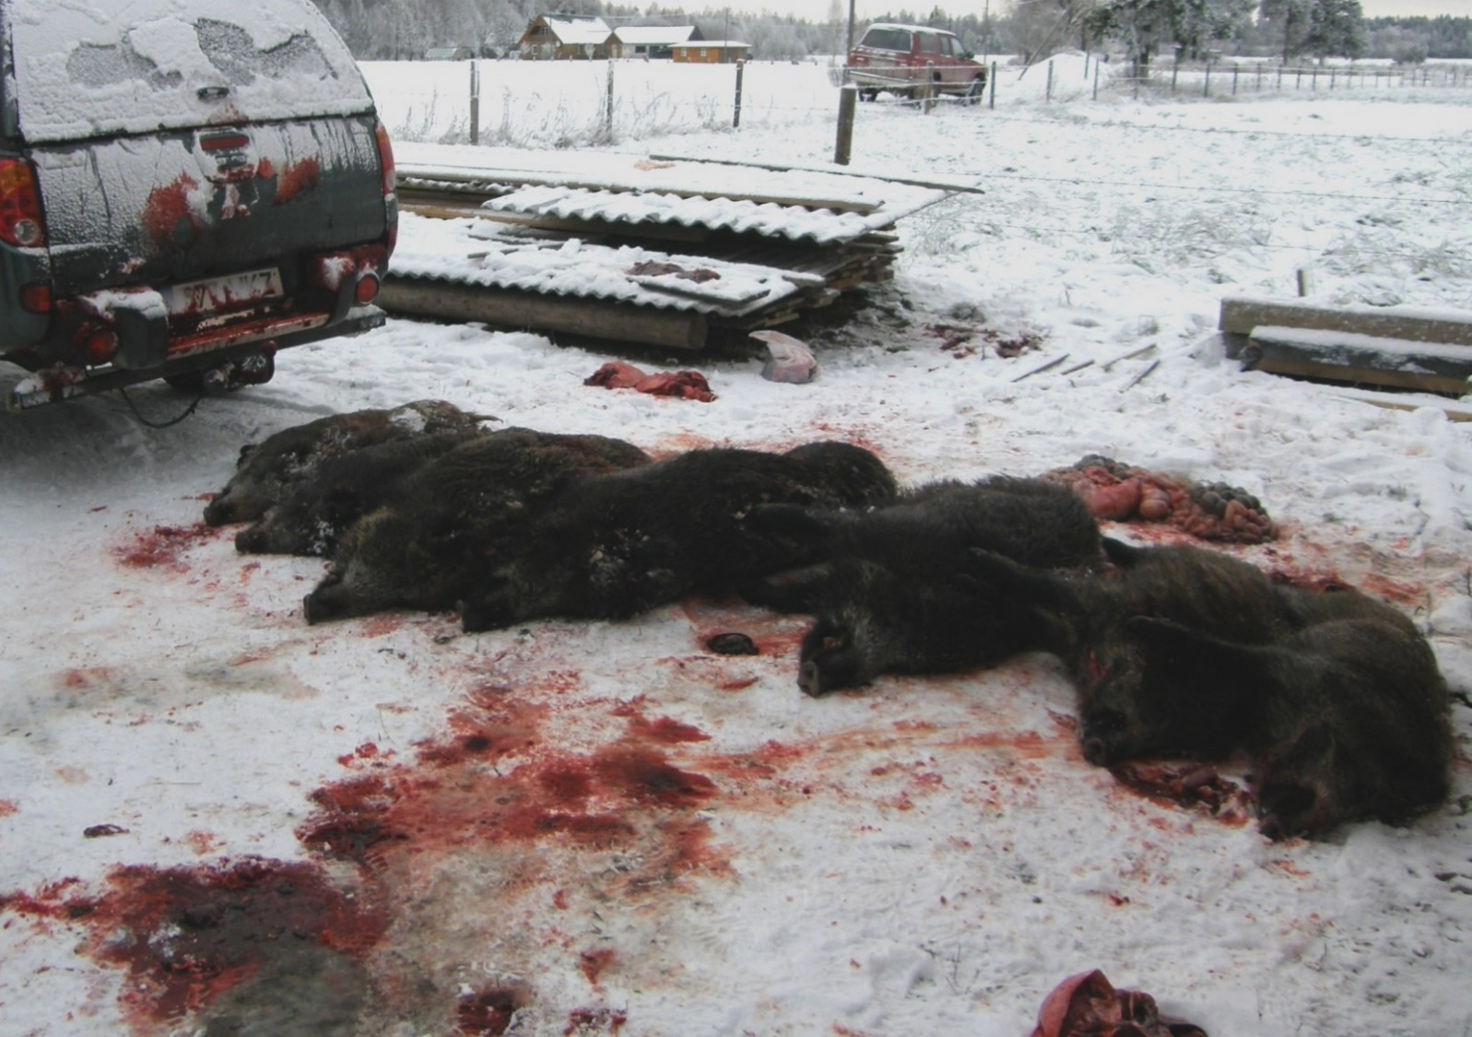
Driven hunt with dogs – effective method to reduce the population density

Slide 20
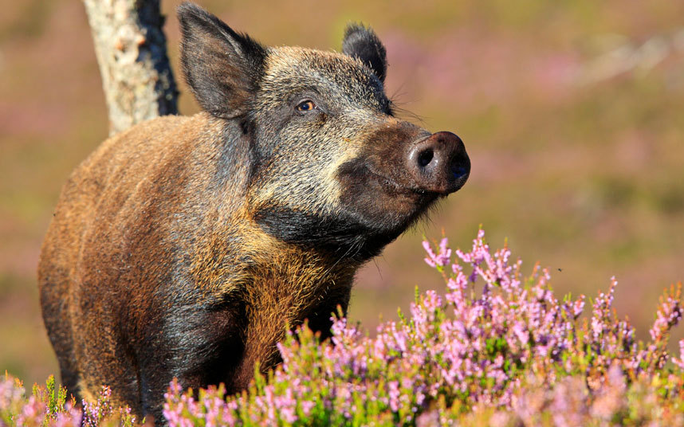
How many wild boars?

Slide 21
Density dependent spread
The number of NEW INFECTED wild boar is proportional to the wild boar population size
The duration of the epidemic is proportional to the wild boar population size

Slide 22
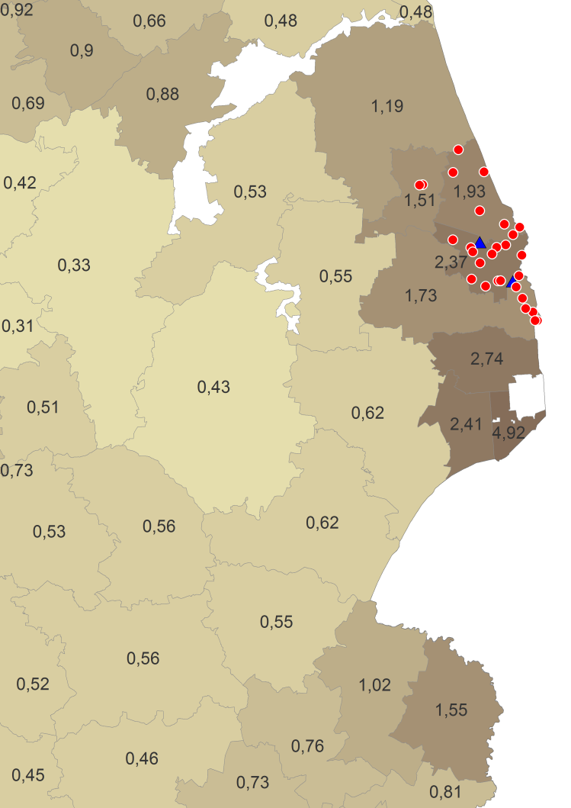
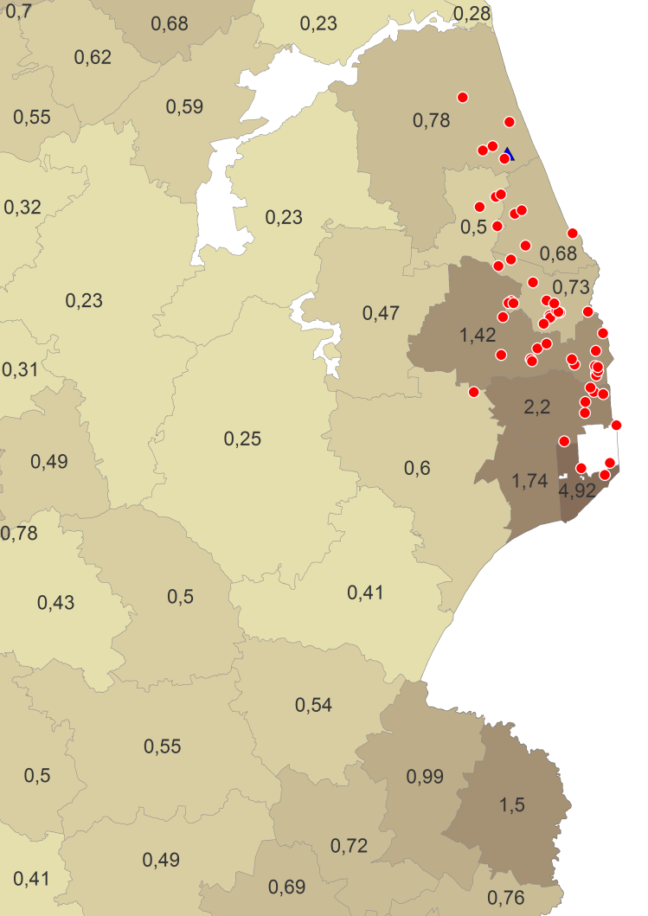
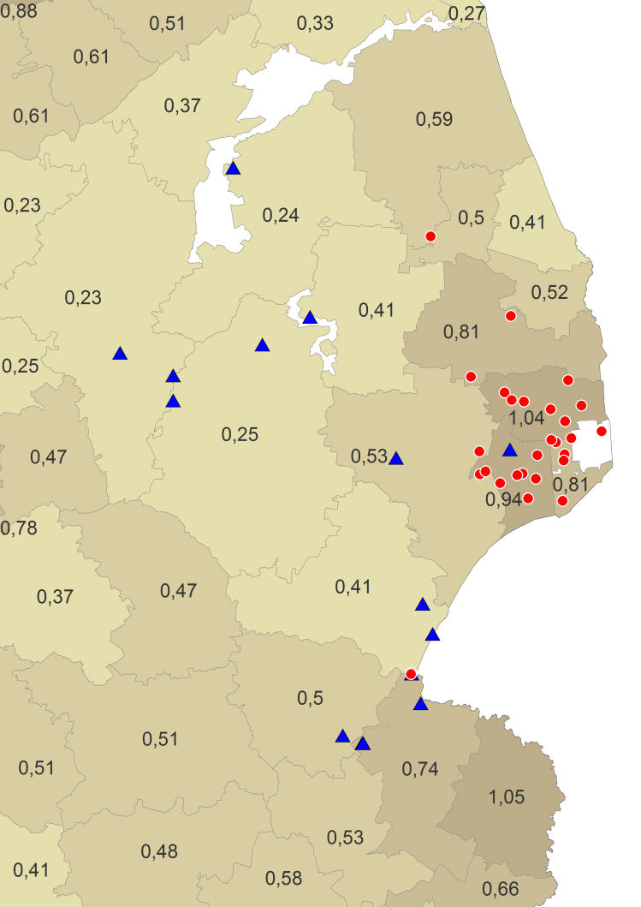
Poland: tendency to spread within areas with wild boar density > 1 individual/km²
2014 – 30 cases
2015 – 53 cases
2016 – 28 cases

Slide 23
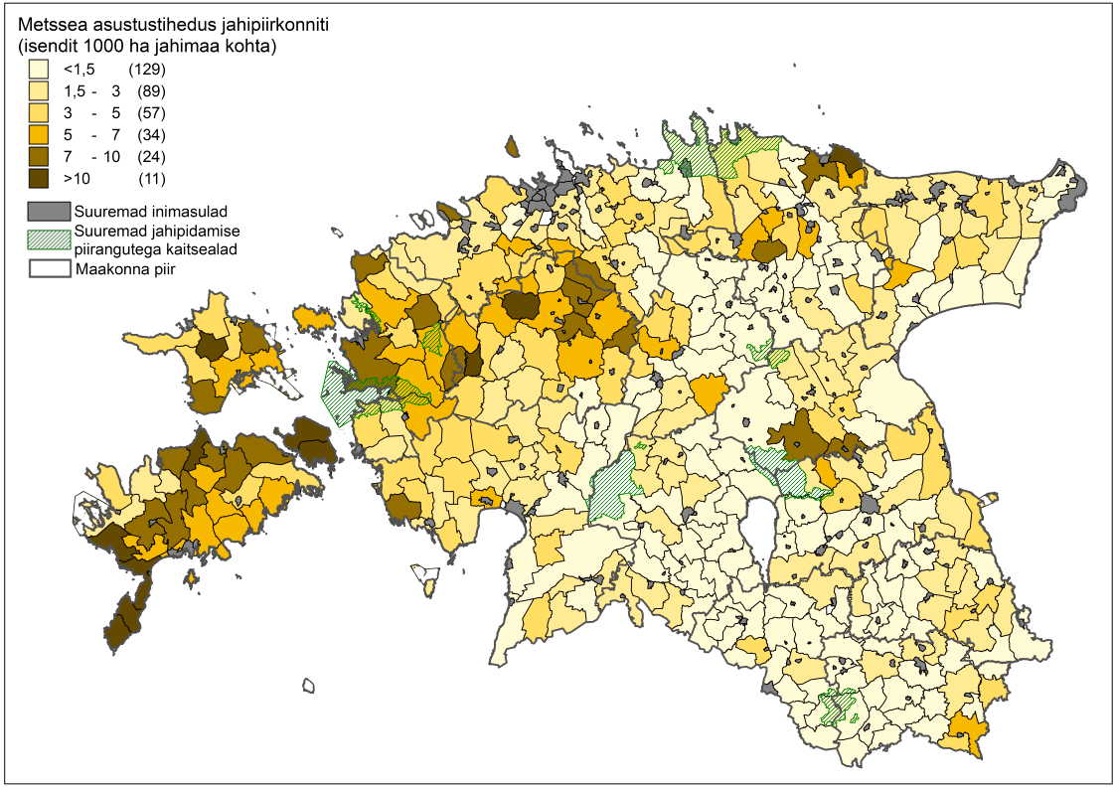

Estonia
0,15-0,3 WB/km²
.
Density of wild boars (individuals per 10 km² of hunting ground) in hunting districts by hunters estimations (census) in spring 2016.

Slide 24
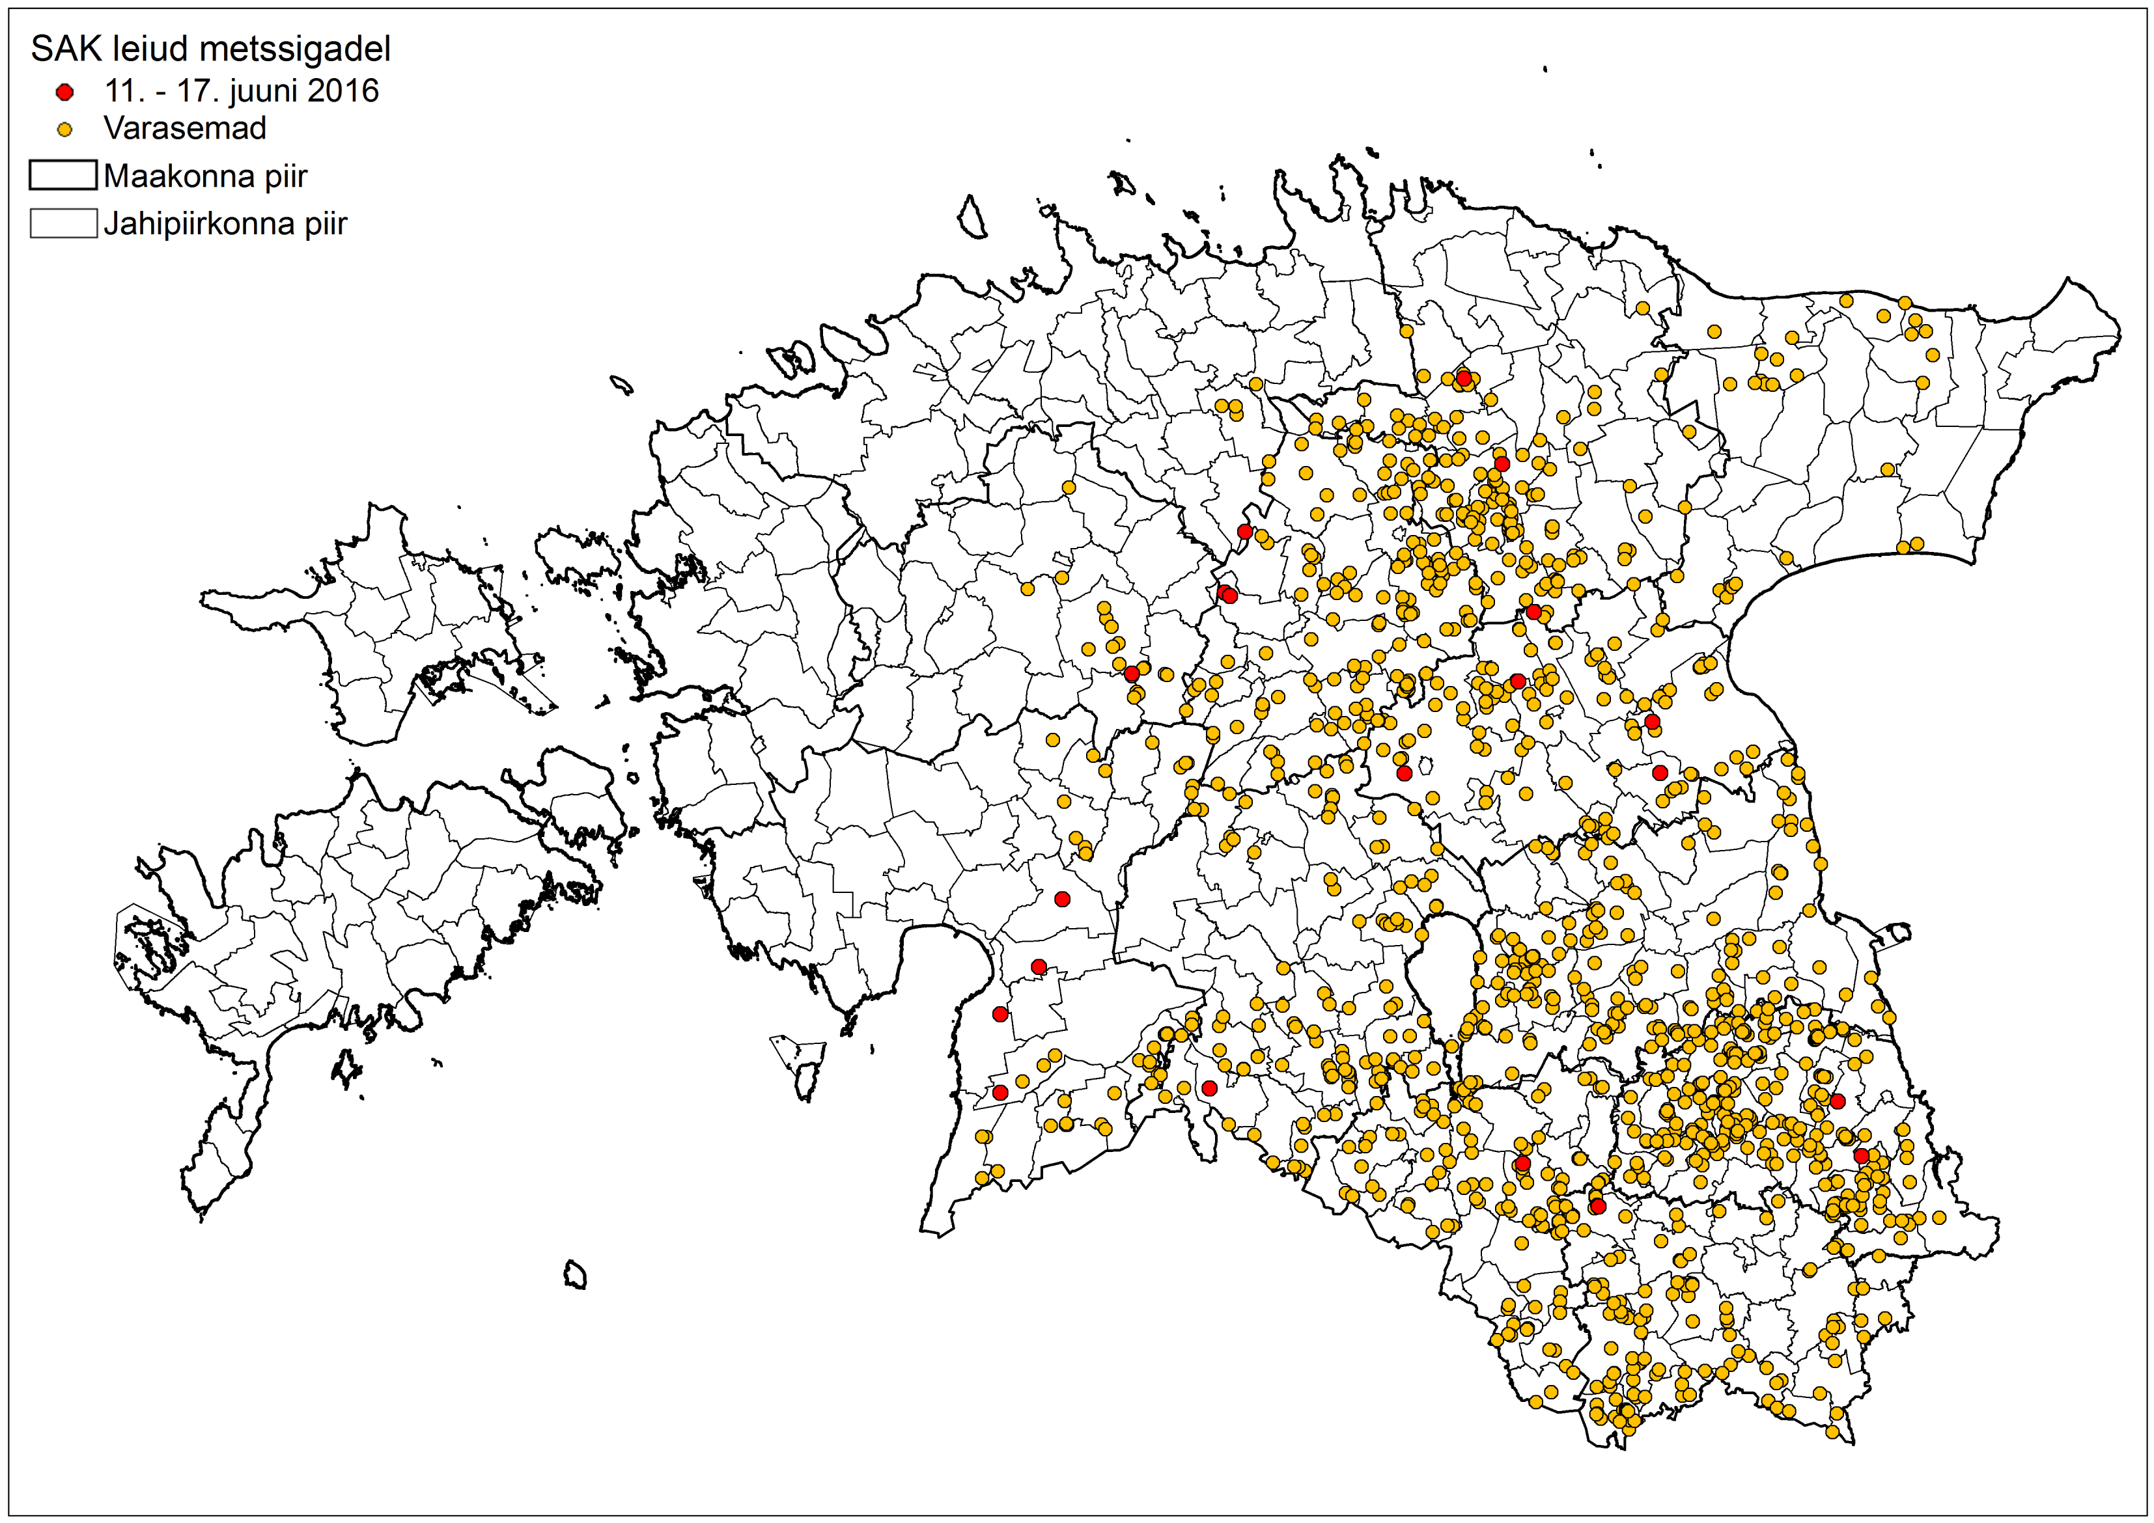

Slide 25
Can we define the threshold density?
The threshold density (nt) is that wild boar density at which an infectious wild boar does not encounter any susceptible wild boar in due time to spread the infection
Duration of infectiousness
Density/availability of susceptible hosts
If the wild boar population size is decreased till a certain density, the infection fade out through a density dependent mechanism
NO WILD BOARS = NO DISEASE

Slide 26
CLASSICAL SWINE FEVER in WILD BOAR
1 year persistence
1000 wild boars

Slide 27
Apparently: not a density dependent spread
WB density

Slide 28
ASF in wild boar
A density dependent transmission during summer-autumn (new born and adult animals)….maggots?
Virus survival during winter with few (or many) infected carcasses according to the local ecological situation
A mixed transmission: density dependent and frequency dependent => NO THRESHOLD!

Slide 29
ASF in wild boar
The question is:
Which is the wild boar density that prevent the contact between a susceptible wild boar with an infected carcass?
An ASF virus will overwinter in a infected carcass……3-4 months…and the virus will appear again during the late spring in alive susceptible individuals

Slide 30
CSF: a density dependent disease
Wild boar threshold density
at which CSF fade out
Through a density
dependent process
Density

Slide 31
ASF in not a truly density dependent infection. The final tail of the infection is determined by carcasses
Density INDEPENDENT transmission
NO THRESHOLD

Slide 32
Practically
Eradication probability increases when: wild boar population size is reduced (as much as possible); carcasses are safely disposed (as much as possible); hunting is carried out under bio-security

Slide 33
ASF: the virus and the environment
Since the infection is not entirely transmitted through density dependent mechanism we have to shift to
The reduction of the environmental contamination of the virus
The problem then is not purely addressed in the mechanistic reduction of the wild boar density but in reducing the viral load of the environment

Slide 34
Standing Group of Experts on African swine fever in the Baltic and Eastern Europe region under the GF-TADs umbrella
SGE ASF3: Moscow, Russia, 15-16 March 2016
Wild boar population reduction should be considered, in combination with other control measures, within the framework of a wild boar management strategy aimed at reducing ASF virus contamination of the environment.

Slide 35
EU strategy (see EFSA, 2015)
Reduce the wild boar population size through targeted hunting of adult females;
Detection of – at least - 50% infected carcasses and their safe disposal
Ban of winter/sustaining artificial feeding
Strategy applied - for at least - 100 km in front of the detected case
It is a medium term strategy that accepts the presence of the virus for a certain number of years

Slide 36
Thanks for the attention

Slide 37
This presentation is delivered under contract with the Consumers, Health, Agriculture and Food Executive Agency (http://ec.europa.eu/chafea). The content of this presentation is the sole responsibility of Opera S.u.r.l., the Istituto Zooprofilattico Sperimentale Lombardia e Emilia Romagna and the State Food and Veterinary Service of Latvia and it can in no way be taken to reflect the views of the Consumers, Health, Agriculture and Food Executive Agency or any other body of the European Union. The Consumers, Health, Agriculture and Food Executive Agency or any other body of the European Union will not be responsible under any circumstances for the contents of communication items prepared by the contractors.
Opera S.u.r.l.
Viale Parioli 96 - 00197 Roma - Italy
Tel +39 06 96042652 / +39 06 8080111
Fax +39 06 89280678
info@opera-italy.it; www.btsftraining.com; www.opera-italy.it
European Commission Consumers, Health, Agriculture and Food Executive Agency DRB A3/042 L-2920 Luxembourg

